Slide 1
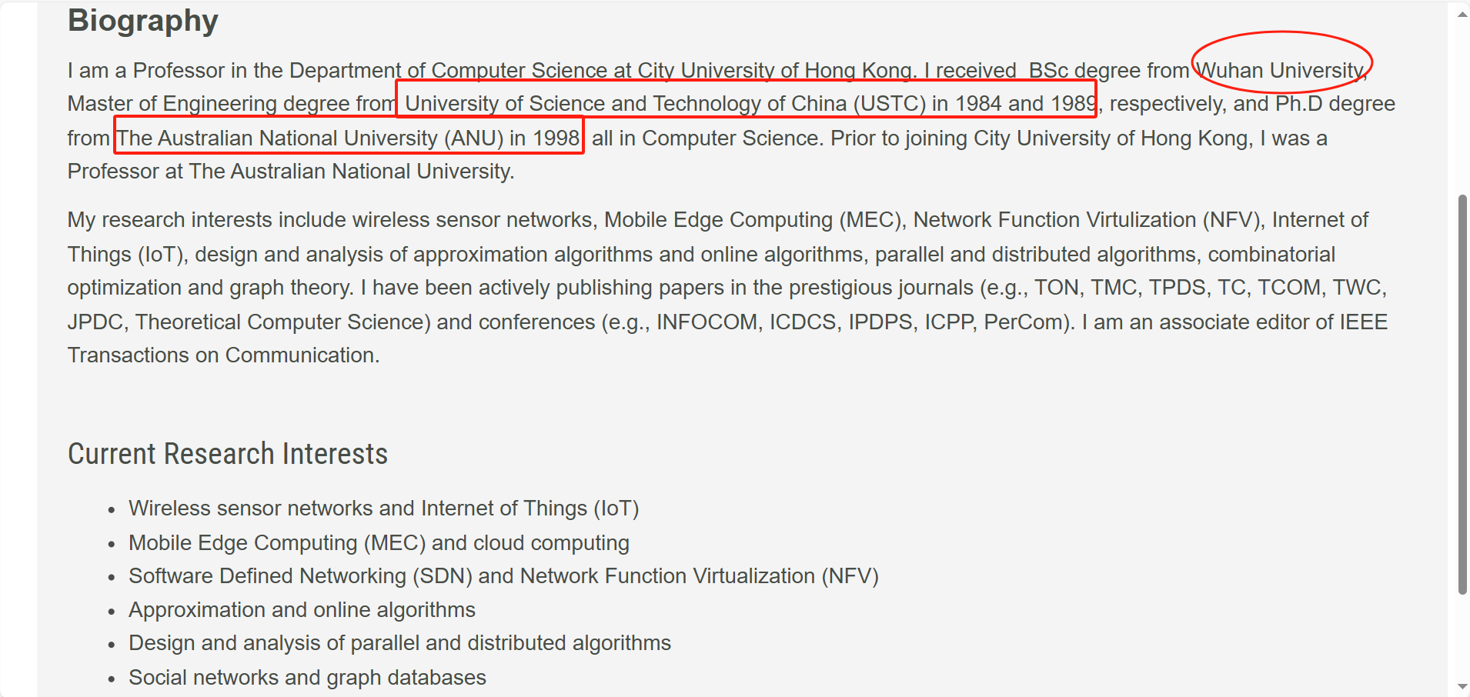
From Liang’s Prof. Page

Slide 2
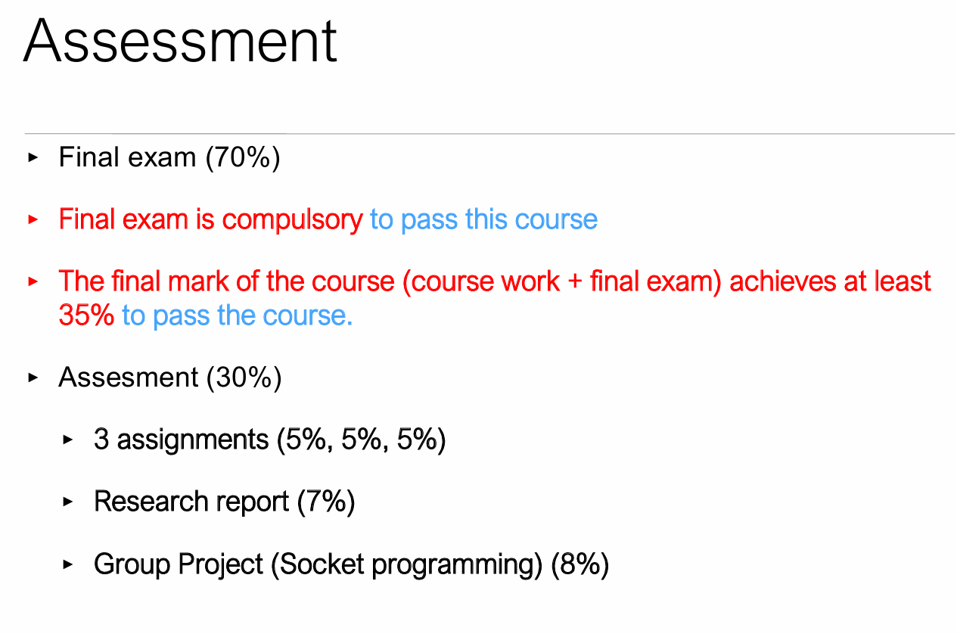
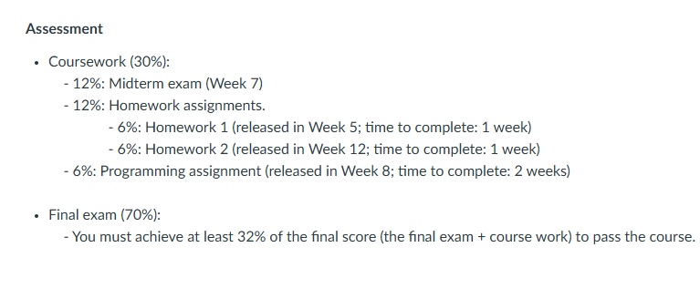
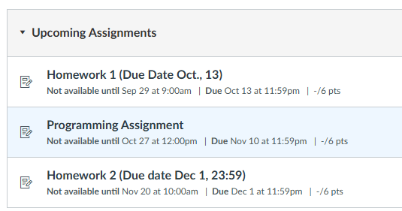
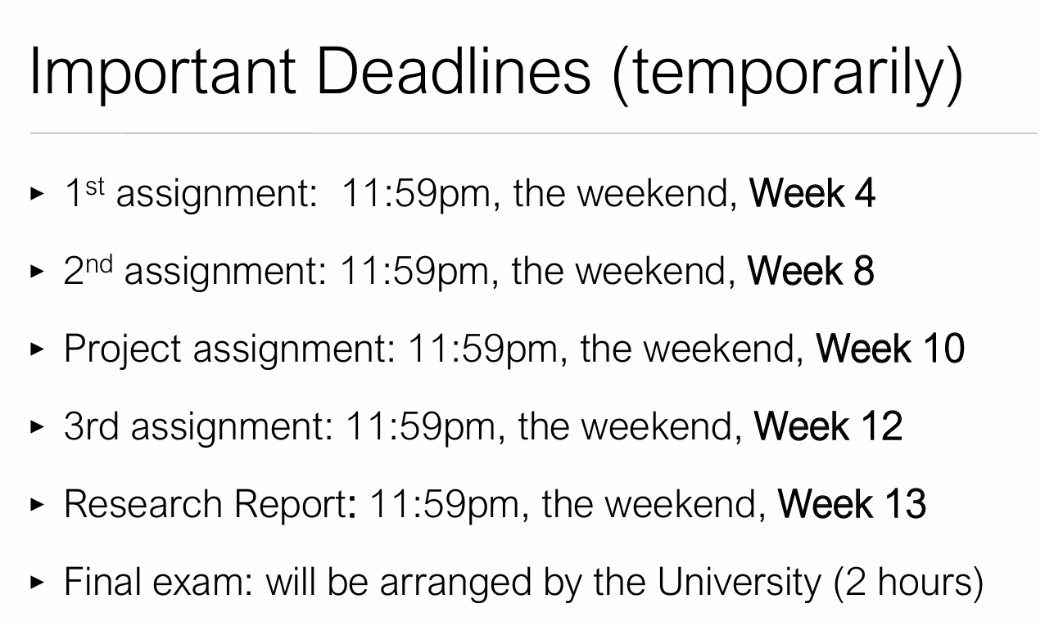
From Logostics-CS5222-2024.pdf
From Canvas course overview

Slide 3
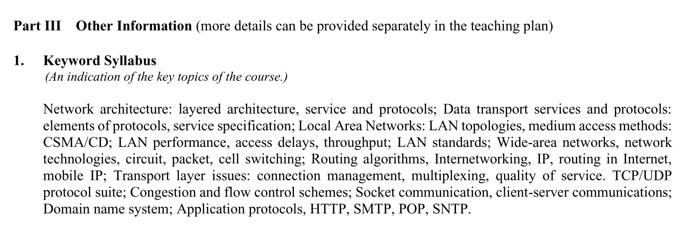
Kurose, J. F. and Ross, K. W. (2017). Computer Networking: A Top Down Approach. Pearson, 8th Edition.
From syllabus.pdf

Slide 4
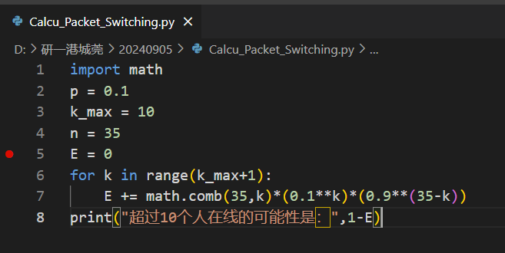

这个active 10% of time 意味着他某时刻0.1可能性在线
P(X>10)在线人数大于10
=1-sigma(k=0,10) C^{k}₃₅)p^{k}(1-p)^{35-k}的，而p=0.1 python中指数：
0.1 ** 2
Math.pow(0.1,2)
Python 中 排列组合：scipy库中的两个模块permutation 和 combination
或者math.comb(n, k)

Slide 5
tutorial1
1(a) L/R=16000*1000/(10**9)(ms)=0.016ms
1(b) 1/(L/R)=62500
2
d_{trans1}=12000*1000/(10**9)=0.012ms
d_{prop1}=2*1000*1000/(3*10**8)=2/300 ms
d_{trans2}=12000*1000/(10**7)=1.2ms
d_{prop2}=1000*1000*1000/(3*10**8)=10/3 ms
d_{trans3}=12000*1000/(10**8)=0.12ms
d_{prop3}=2*1000*1000/(3*10**8)=2/300 ms
一共是d=0.012+0.067+1.2+3.333+0.12+0.067=4.678ms
3(a)??? 20% of the users? Or 1 user Answer: 10/5=2 users.
3(b)Answer: Probility: comb(4,3)*(0.2**3)*0.8+comb(4,4)*(0.2**4)=0.0256+0.0016=0.0272
4(a)20Mbps
4(b) The four links from the servers to the shared link（first hop，因为比300/4和60都小）
4(c)links from servers to shared link:100%, shared link: 80/300=26.67% , links from shared link to clients : 20/60=33.33%
答案：https://www.studocu.com/hk/document/city-university-of-hong-kong/computer-networks/tutorial-1-solutions/36443433

Slide 6
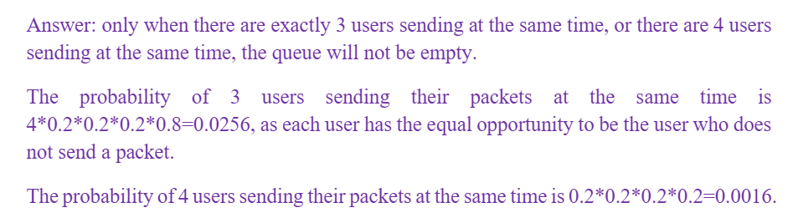
其中第三题，有点P4的packet switching概率题

Slide 7
Tutorial 2
1.
1)(right)TCP conection : 2RTTs,8 objects:16 RTTs 18RTTs
2)(false)TCP connection: 2RTTs,8 objects:8 RTTs 10RTTs
2)2RTTs+1RTT=3RTTs
2.
A. (1-p)^{N},
B.1-(1-p)^{N} times on average per packet
1/(1-p)^N
3.
4.5*1500bits/2Mbps=3.375ms
4.????
首先，没有决定排队顺序的延时
(right)(i-1)L/R,
(right)(i-2)L/R
(N-1)L/2R-----------(N/2-1)(L/R) 因为i是从1开始而不是从0开始

Slide 8
Deducted
Plagiarisms
Panel 专家小组
Scenario 方案

Slide 9
两道题，好像是教材课后习题？ P6(right)
R bps
s m/s
A
L bits
B
m meters
a,.d_{prop}=m/s(s)
b.d_{trans}=L/R(s)
c.d_{nodal}=d_{trans}+d_{prop}=m/s+L/R (s)
d. just at the begin (A side) of the link 还是说要表达刚刚踏上线路
e. On the link,which is far away from A , the distance is s*d_{trans} (m) 还是说整个packet全部都搭上链了才开始一起传
f. At B buffer
g. If d_{prop}=d_{trans} , then m=L*s/R = 120bits*2.5*10⁸m/s / 56*10³ bps =5.357*10⁵m

Slide 10
P31(right)
a,.Message: 8*10⁶ bits
Link transport rate: 2Mbps
a. T_{s-h1}= 8*10⁶bits/2Mbps=4s T_{s-d}=3* 8*10⁶bits/2Mbps=12s
b. t_{s-h1}=10000bits/2Mbps=0.005s t_{b2}=2*10000bits/2Mbps=0.01s
c. t_{s-d}= 8*10⁶bits/2Mbps+2*10000bits/2Mpbs=4.01s t_{s-d}<T_{s-d} using message segmentation saved time a lot. The larger message and more switch it uses, the more obvious saving effect it shows.
d. 1.for information security 2.and if there are some packets lost, the source can just resend the lost part rather than resent the whole Message 3.Saving the buffer memory size
e. 1.The process of segmenting and reassembling make processing time larger. 2.An increase in the number of packets leads to a higher total amount of data headers.

Slide 11
WhatsApp: WhatsApp is renowned for its end-to-end encryption, which is facilitated by the Signal Protocol. This protocol ensures that messages, calls, photos, and videos sent over WhatsApp are secured and can only be read by the intended recipients. For voice and video calls, WhatsApp employs the Secure Real-time Transport Protocol (SRTP) to provide encryption, integrity, and authentication of the media stream. The application also uses a combination of HTTP and TCP for communication over the internet, with mmTLS (mobile-optimized Transport Layer Security) to secure these connections.
Citation: "WhatsApp." Wikipedia, Wikimedia Foundation, https://en.wikipedia.org/wiki/WhatsApp.
WeChat: WeChat, developed by Tencent, operates on a variety of protocols to ensure efficient and secure communication. It primarily uses HTTP and TCP for stable data transmission. For added security, WeChat employs mmTLS, which is designed to provide a secure connection tailored for mobile devices. Additionally, WeChat utilizes a combination of MTProto (a custom protocol developed by Telegram) and HTTPS to enhance the privacy and security of its messaging service. UDP and DNS are also part of the technology stack that WeChat uses for its operations.
Citation: "微信背后的网络运作 - Mincong Huang." https://mincong.io/cn/wechat-network/ "WeChat." Wikipedia, Wikimedia Foundation, https://en.wikipedia.org/wiki/WeChat.

Slide 12
 | Wechat
登陆验证、头像身份信息、日志 | HTTP
文本消息、语音消息、视频消息、图片消息 | TCP mmTLS^{[1]}
视频聊天 | UDP | 使用 SRTP 加密
 | DNS
end-to-end encryption, for messages, calls, photos, and videos | a combination of MTProto and HTTPS | Signal Protocol
payments and sensitive data
broadcast (one-to-many) messaging
共享他們的位置
掃描二維碼
 |  | XMPP
1、按照功能
登录
传输文字
传输图片
通话
打视频电话
传输文件
2、按照协议层数
https://en.wikipedia.org/wiki/WhatsApp
微信背后的网络运作 - Mincong Huang
https://en.wikipedia.org/wiki/WeChat

Slide 13
SNMP是啥？ 应用层协议，主要管理局域网中的路由器等等设备用的，simple network management protocol

Slide 14
Tutorial 3
1. (right)他是按照包来发送的叭？和包的大小无关喽？（后面说法是对的）
1Gbits/10Mbps=100s
2.这个是要包括握手的时间差么？——访问local DNS cache不需要握手
2RTT0+2RTT1=40msecs
RTT0+2RTT1=35msec
3.a: List the sequence是什么意思？？是说路径么
DNS message1 : Local DNS server →R1 →Internet → R1 → Local DNS server
DNS message2 : Local DNS server →R1 →R2→Authoritative DNS server for b.com → R2→R1 → Local DNS server
HTTP message1 : m1.a.com → HTTP cache → Local DNS server →R1 →Internet → R1 → Local DNS server → HTTP cache → R1 → Internet 1Gbits/1Mbps=1000s
HTTP message2 : m1.a.com → HTTP cache → Local DNS server →R1 →R2→Authoritative DNS server for b.com → R2→R1 → Local DNS server → HTTP cache → R1 → R2 → www.b.com
DNS: m1.a.com→Local DNS server→Internet →m1.a.com(→TLD→.com→m1.a.com→ Authoritative DNS server for b.com??)
3.b.??没看懂啊真的没看懂这题目
DNS:m2.a.com→Local DNS server→m2.a.com
HTTP message: m2
4. The website add the url into the html file which records the historical browsed items and add some recommendations. (2)by cookies Amazon remember who the browers is and guide the accessing url into the very html file made up for the very consumer.
5.a: 11 request messages, 2*3=6 RTTs (2RTTs for HTML,2 for 5 objects, 2 for 5 objects)
5.b: 5 request messages, 3 RTTs
5c. 11 request messages, 2*11 =22 RTTs
5d. 1 request messages, 12RTTs 3RTTs

Slide 15
3.a
首先m1去local DNS，DNS message，时间0
然后Local DNS 去Internet里找root DNS server，DNS message, 500ms
它返给Local DNS一个.com的 DNS Top Level Domain server， DNS message, 500ms
于是Local DNS去找TLD要， DNS message, 500ms
TLD返给Local DNS b.com DNS(authoritative name server)，DNS message,500ms
Local DNS 去authoritative name server,DNS message,时间0
authoritative name server返回www.b.com的IP地址给Local DNS，DNS message,时间0
接下来直到建立TCP连接（Local DNS→m1→www.b.com→m1）都是时间忽略
M1→www.b.com→HTTP cache, HTTP GET message,时间0
M1→www.b.com→HTTP cache, HTTP GET message,时间0

